Slide 1

Heart Failure Survival Analysis 2026 Michigan Data Science Team Project Sina Bonakdar Terry Zhang

Slide 2
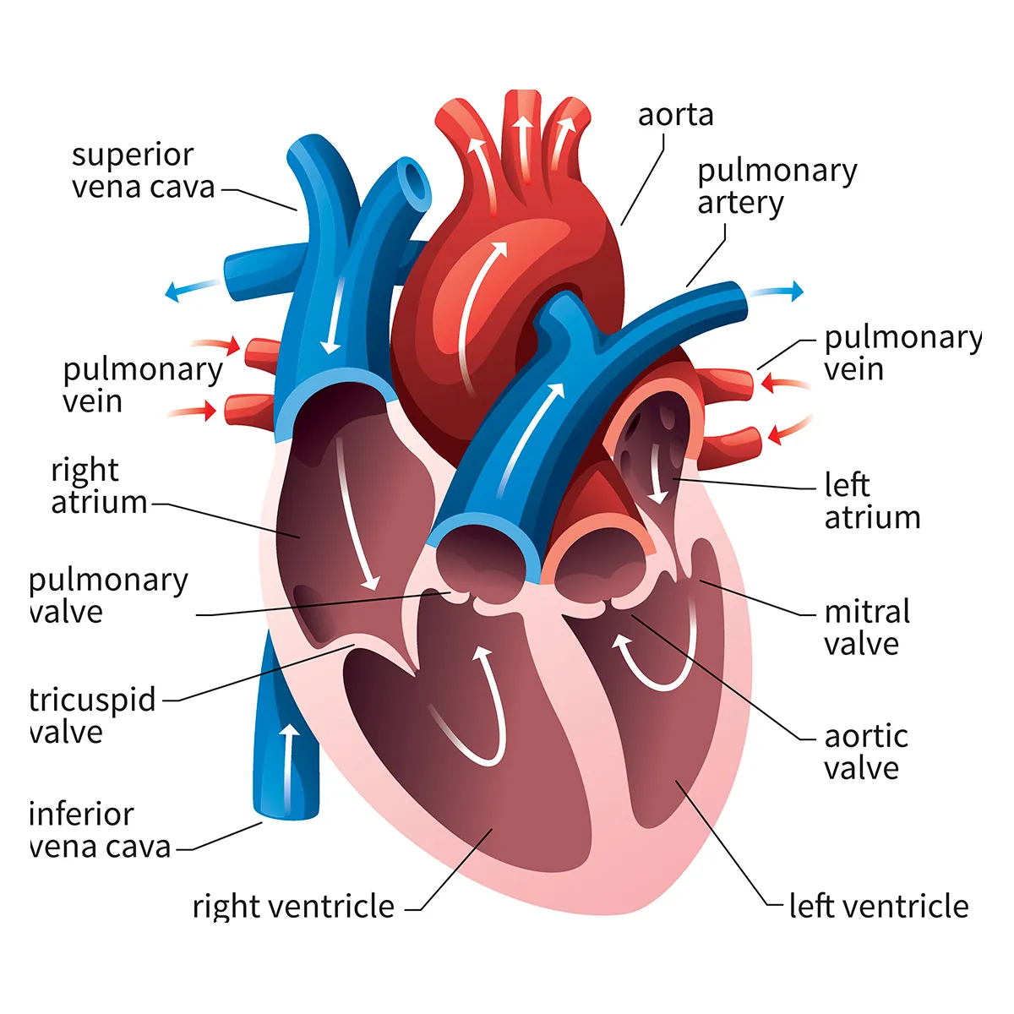
Heart Failure Survival Analysis
What is Heart Failure?
When the heart cannot pump sufficient blood
Not all heart failures lead to death.
Two types of heart failure:
Reduced ejection fraction (<40% ejection fraction), indicating ineffective heart contraction
Preserved ejection fraction (left ventricle is stiff and cannot relax and fill properly)
Goal:
a) Use machine learning and deep learning classifiers to predict survival event in heart failure patients
b) Identify the most critical parameters affecting survival => provide insights to physicians to tailor treatments more effectively and reduce mortality
Our focus
Notes:
Ejection fraction: is the percentage of blood that heart pumps out.
Low oxygen blood from body → right atrium → right ventricle → lung
High oxygen blood from lung → left atrium → left ventricle → body

Slide 3
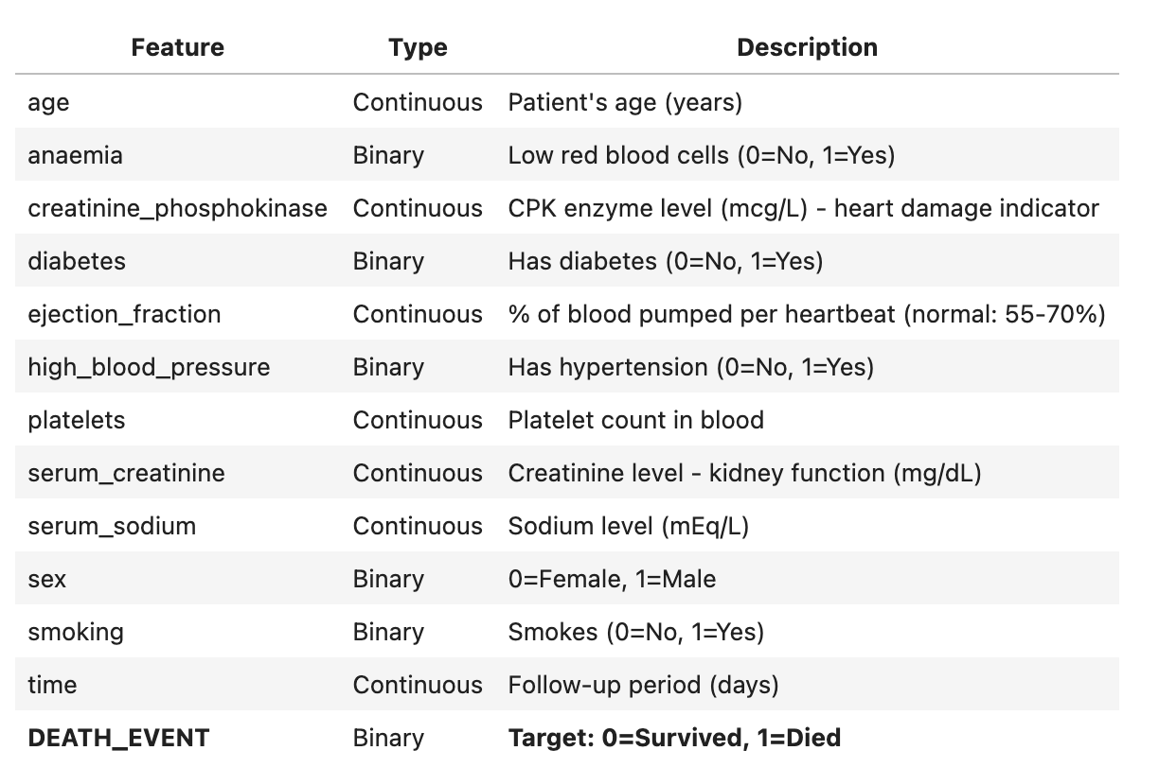
Feature Explanations
Survived | Died
203 | 96

Slide 4
Methods
Python
Feature selection
Data Visualization
Statistical Analysis
Unsupervised learning
Supervised learning
Use different ML evaluation metrics
Use ML Interpretation tools

Slide 5
Accomplishments
Data Visualization
Statistical Analysis
Unsupervised Learning, Dimensional Reduction, and Confusion Matrix
Design Machine Learning Algorithms
Evaluation Metrics
Design Multi-layer Perceptron
AI Interpretation Tools

Slide 6
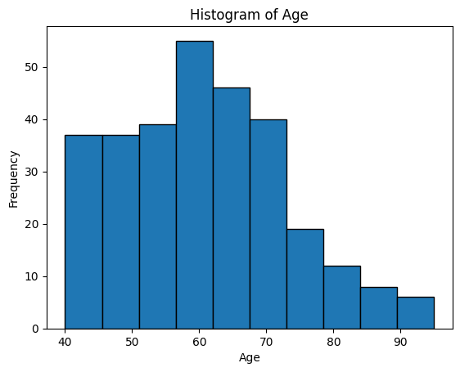
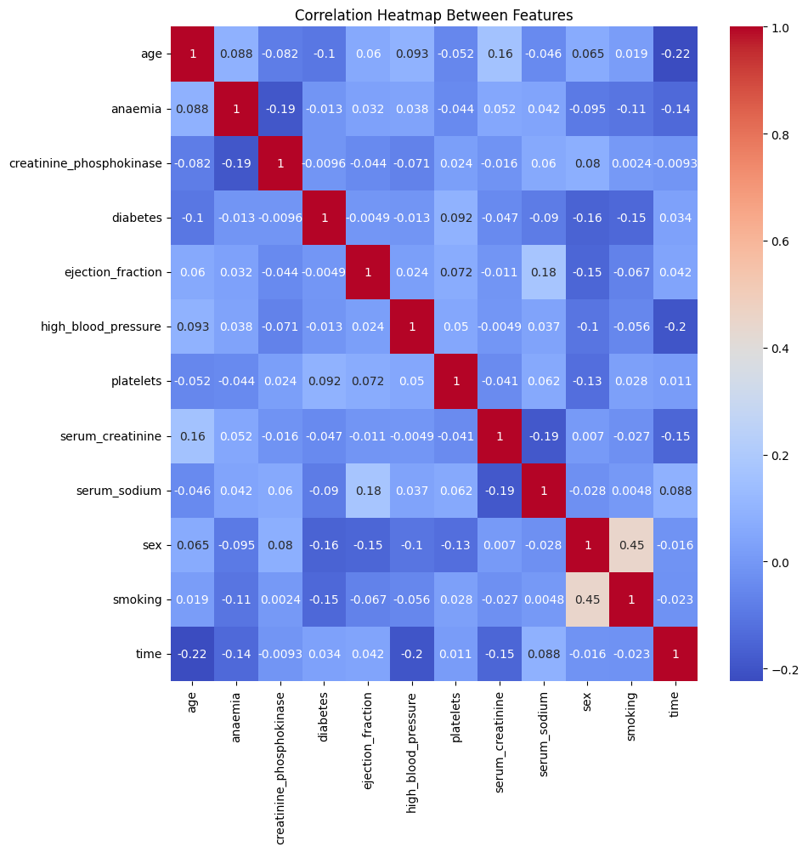
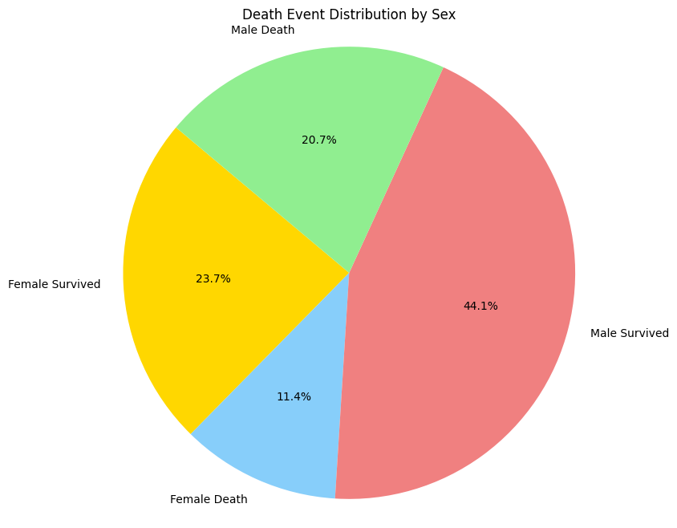
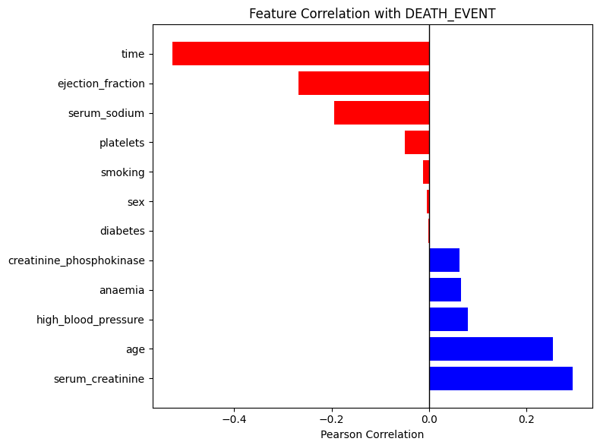
Data Visualization & Statistical Analysis

Slide 7
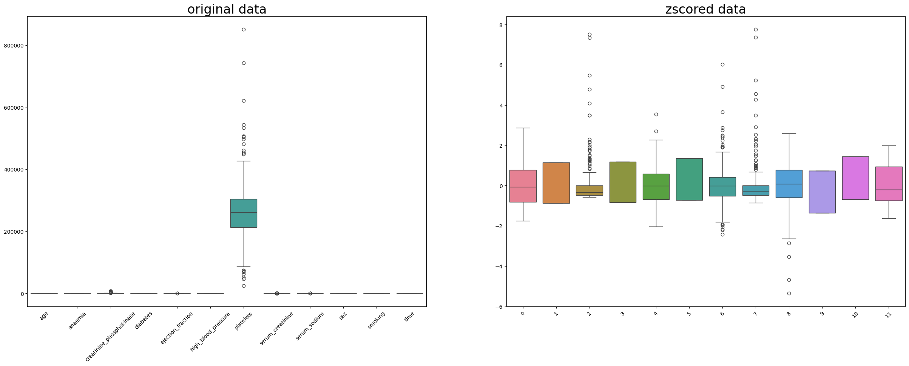
Data Explanation and Preprocessing
How to work withNumPyand Pandasdataframe
Data Normalization (zscore)

Slide 8
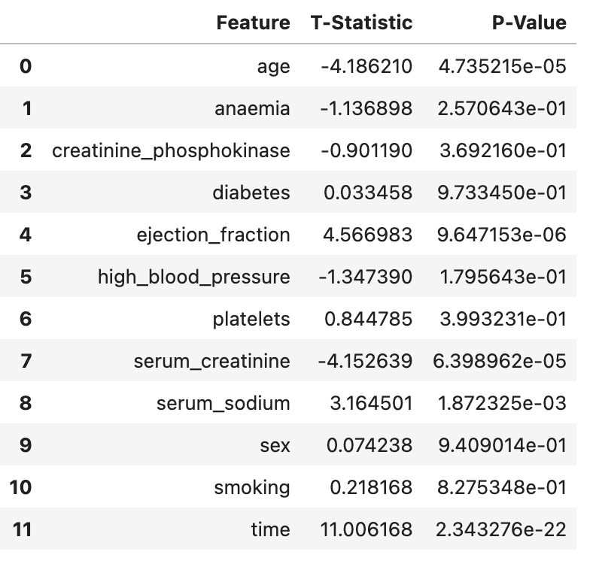
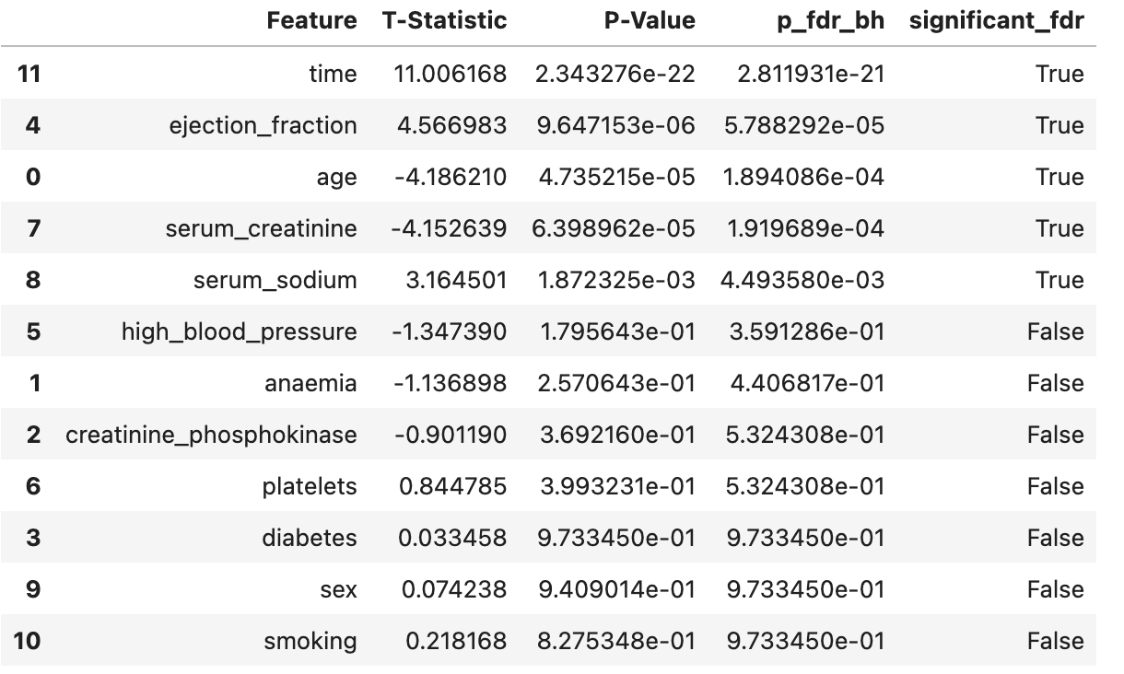
Statistical Analysis
Mann-Whitney U test and Multiple Hypothesis Test
Two-sample t-test

Slide 9
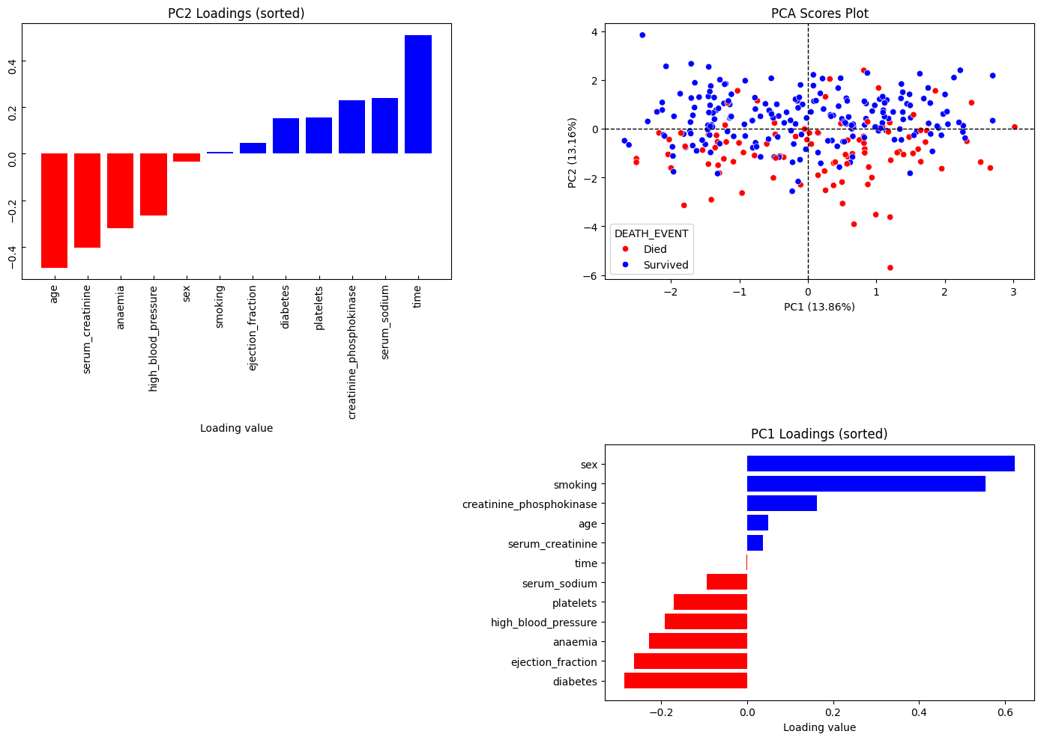
Unsupervised Learning
Principal Component Analysis

Slide 10
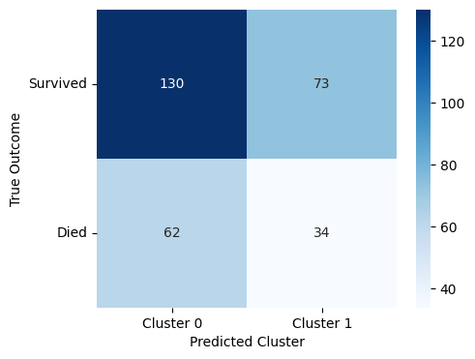
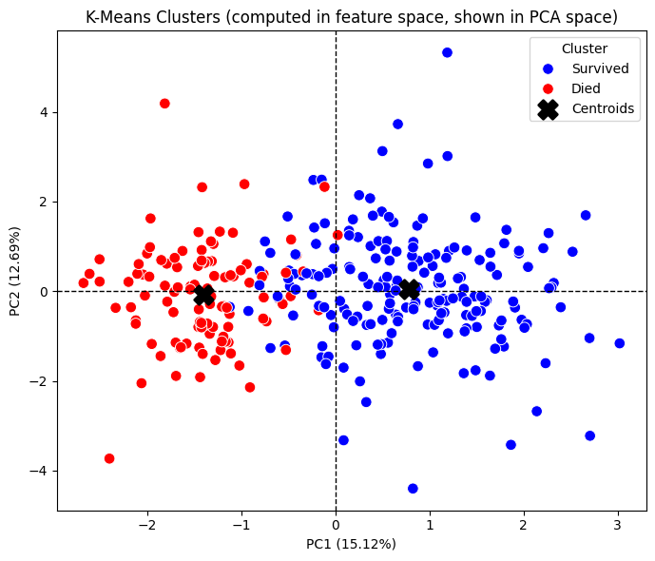
K-means Clustering
Condusion Matrix of K-means clusters

Slide 11
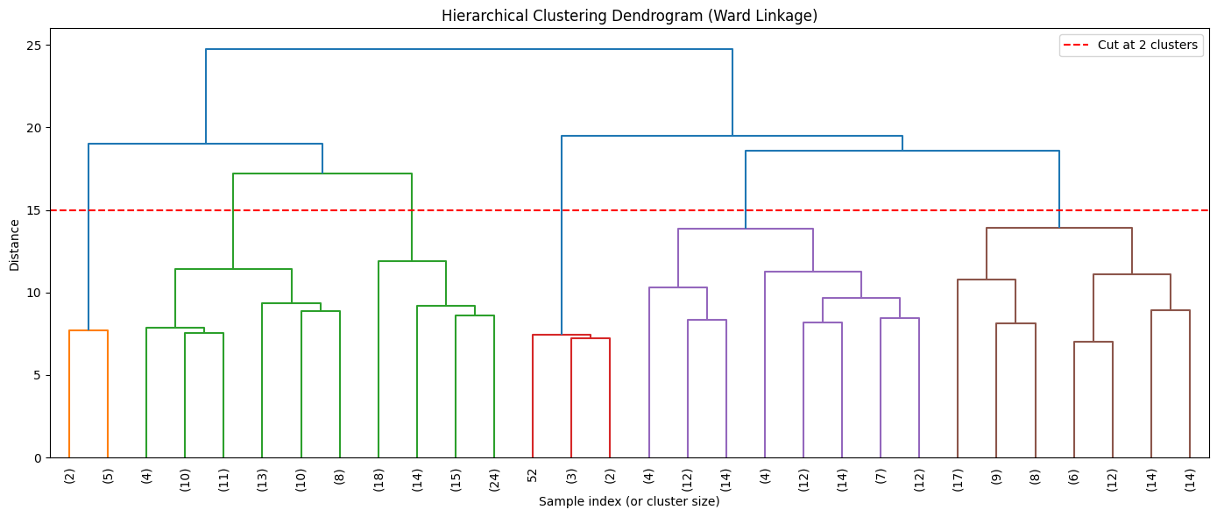
K means & Hierarchical Clustering

Slide 12
Design ML Classifiers
Steps:
Create train-test split
Data Normalization
Model Training
Prediction on test set
Evaluation
Model Name | Accuracy | Precision | Recall | F1-Score
Dummy Model | 0.68 | 0 | 0 | 0
K-Nearest Neighbors | 0.67 | 0.47 | 0.28 | 0.35
Linear SVM | 0.7 | 0.55 | 0.41 | 0.47
Kernel SVM | 0.73 | 0.62 | 0.45 | 0.52
Random Forest | 0.72 | 0.58 | 0.52 | 0.55
Logistic Regression | 0.71 | 0.58 | 0.38 | 0.46

Slide 13
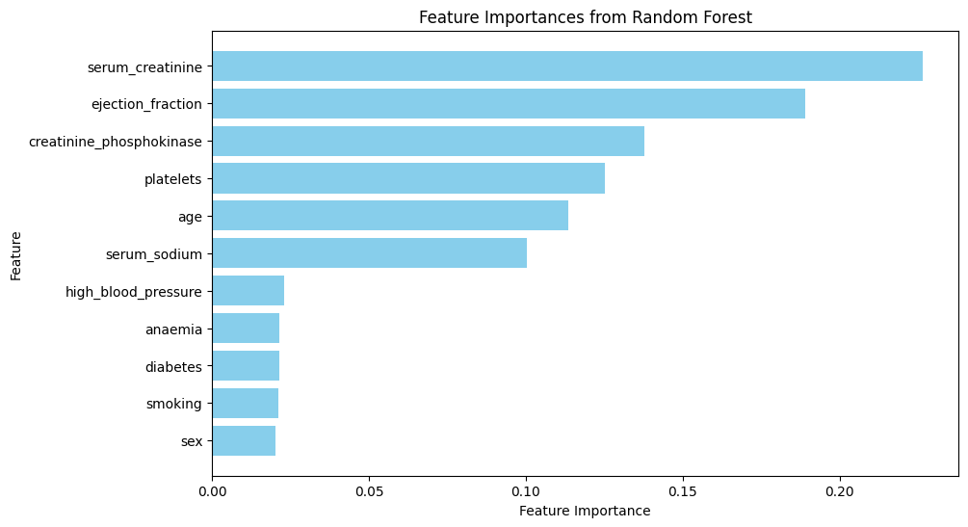
Feature Selection Methods
Ejection Fraction, Serum Creatinine
Accuracy | 0.79
Precision | 0.69
Recall | 0.62
F1-Score | 0.65
Random Forest model performance reaches 80% accuracy with top 2 features!

Slide 14
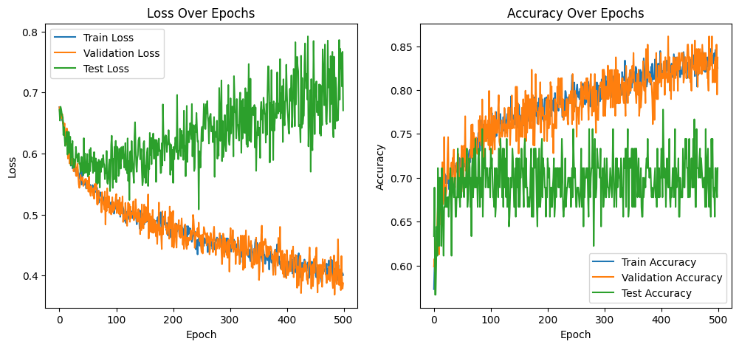
Deep Learning: Multi-layer Perceptron

Slide 15
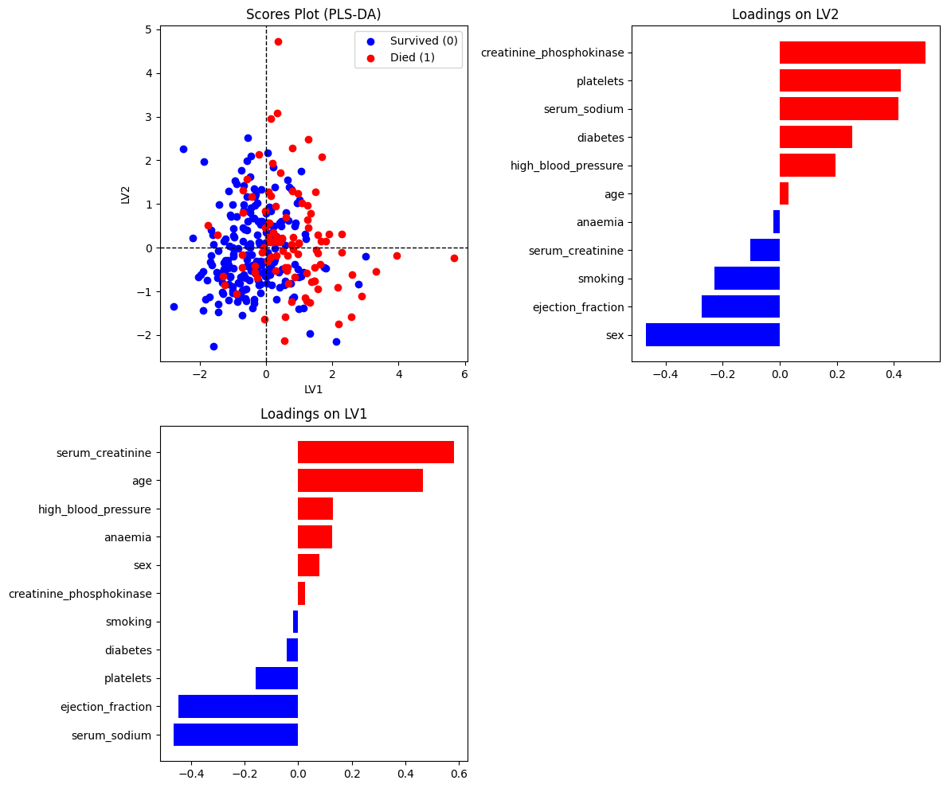
AI Interpretation Tools
PLSDA

Slide 16
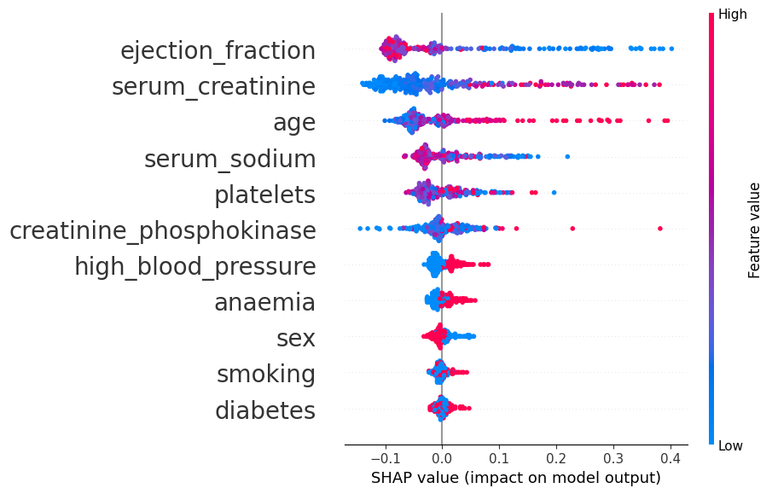
SHAP on Random Forest
Survived
Died

Slide 17
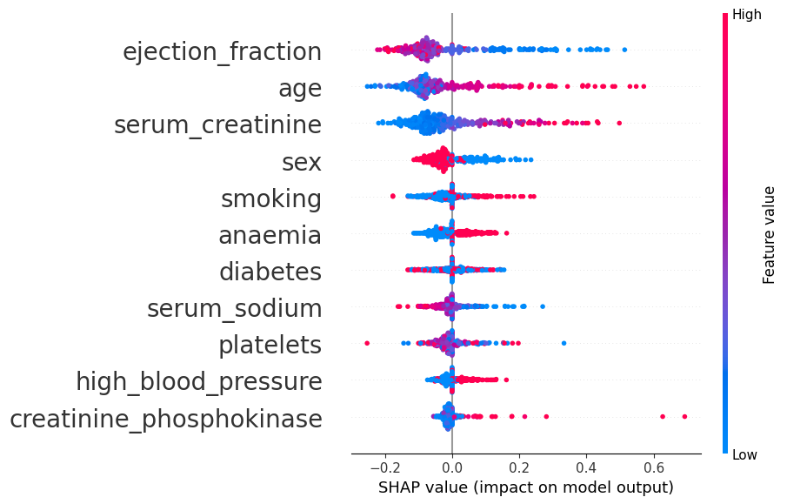
SHAP on MLP
Survived
Died

Slide 18
Conclusion
From multiple analysis two features identified as the most important predictors for survival event in heart failure patients (Ejection Fraction, Serum Creatinine).
Smoking and gender identity contribute less to the event.
A simple model (Random Forest) performed better than complex Deep Learning models, due to the limited size of samples.

Slide 19

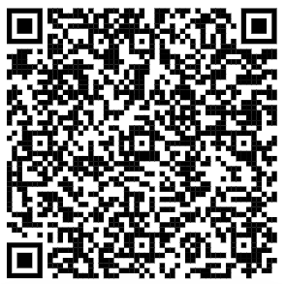
References
Chicco, D., Jurman, G. Machine learning can predict survival of patients with heart failure from serum creatinine and ejection fraction alone. BMC Med Inform Decis Mak 20, 16 (2020). https://doi.org/10.1186/s12911-020-1023-5
MichiganDataScienceTeam/W26-MDST-Project_Heart-Failure-Survival-Analysis

